Slide 1

Layout Instruction
AIC 2009
1

Slide 2
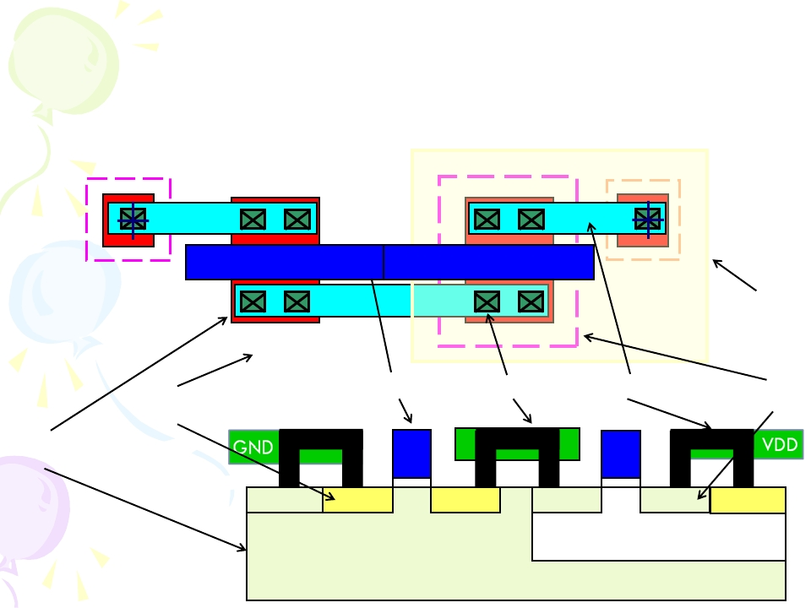
CMOS Process Flow
GND
VDD
N well
Poly-Gate
Contact
Metal 1
p+ implant
N+
implant
Active area (OD)
p+
N+
N+
p+
p+
N+
c
N-well
2
P-substrate

Slide 3
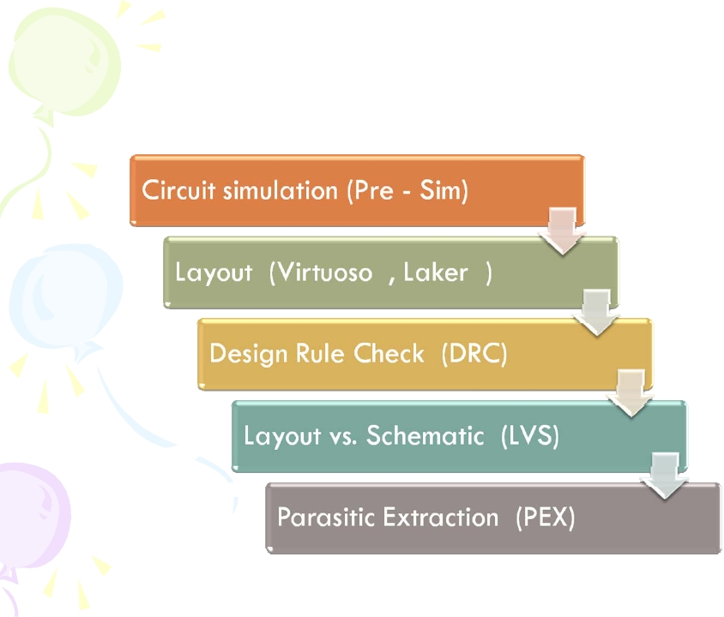
IC-Design Flow
3

Slide 4
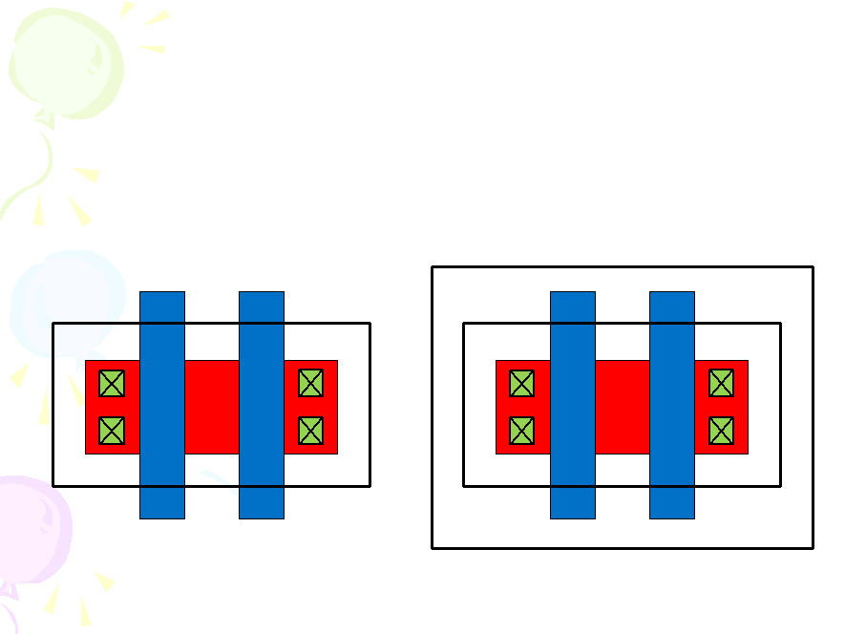
CMOS Process Flow
4
Design Rule check : Reserve the space and the capability for the
process fabrication (Refer to the design rule )
4

Slide 5
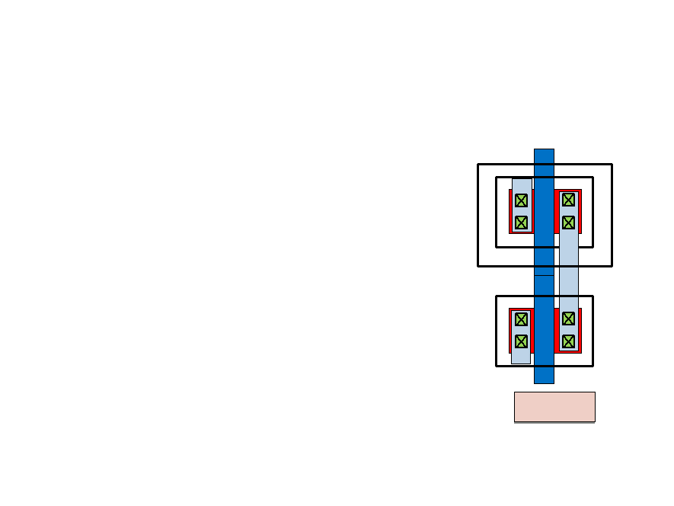
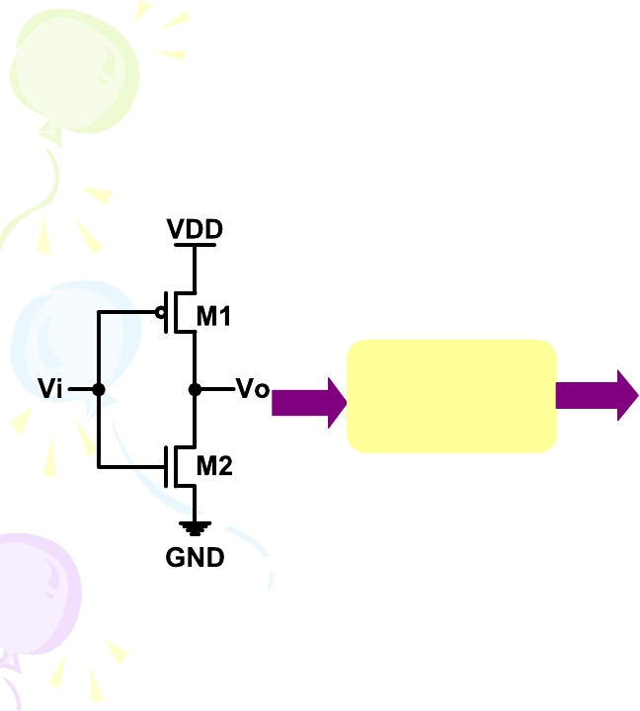
Layout vs. Schematic (LVS)
5
LVS
Vi
Vo
Layout
5

Slide 6
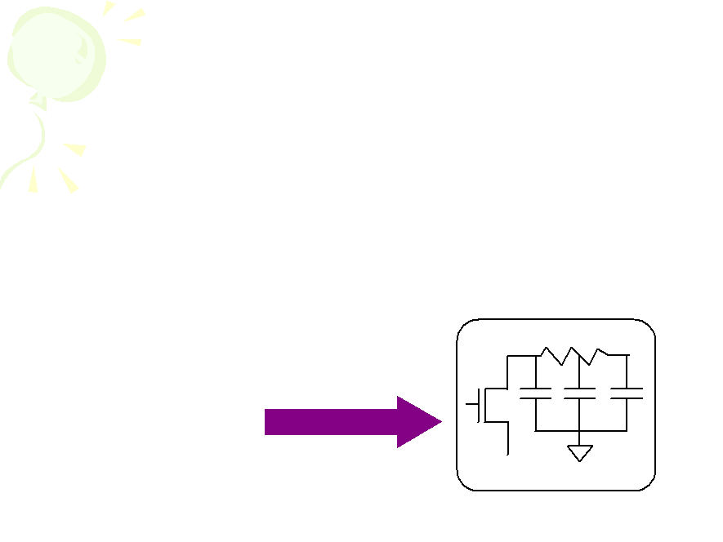
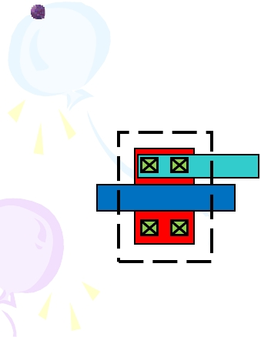
Parasitic Extraction (PEX)
6
Parasitic : resistance and capacitance nor intentionally design into a
chip but are consequences of the layout.
Post layout Simulation : The real signal line has impedance and load, it
will cause the difference between the original circuit and layout .
RC extraction
6

Slide 7

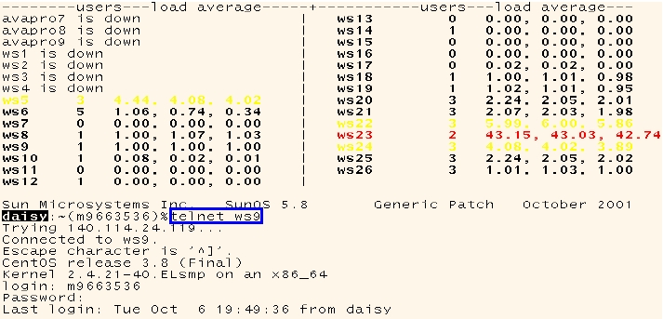
How To Start Laker ?
Execute X-Win
Connect to the work station by telnet.
Laker &
7

Slide 8

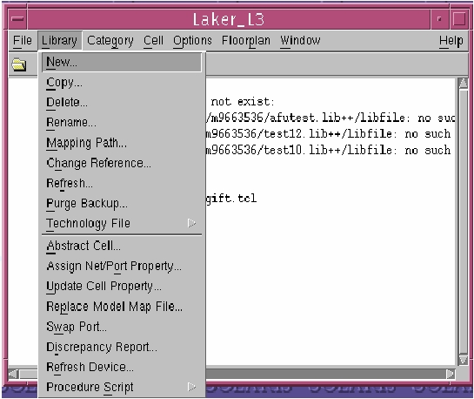
Laker Environment
8
Main Window -> Library -> New
8

Slide 9
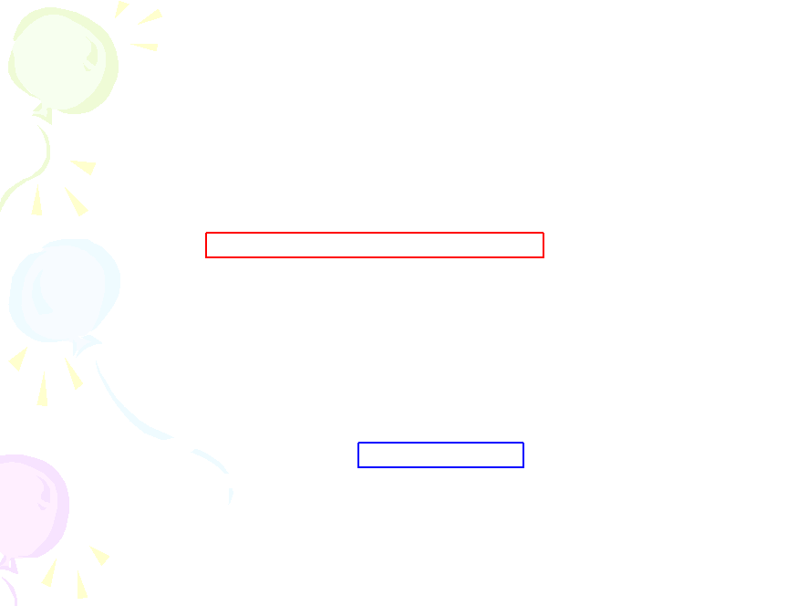
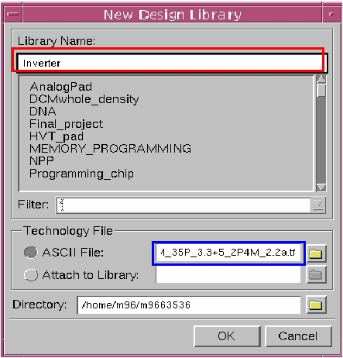
Laker Environment
9
Key Library Name ->Select Technology File
9

Slide 10

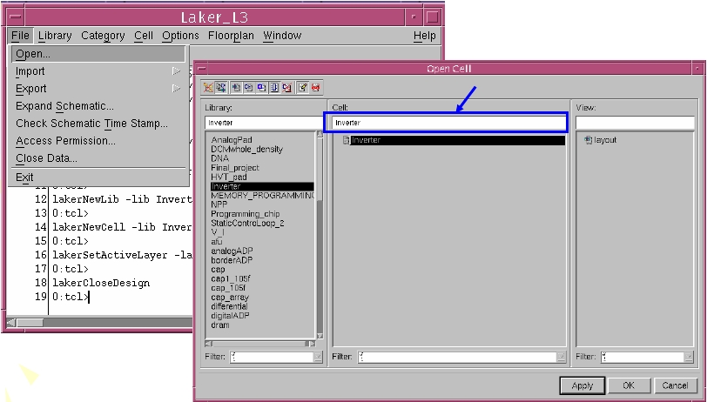
Laker Environment
10
File-> Open -> Choose Library -> Cell (Key in Name)
Key in Name
10

Slide 11
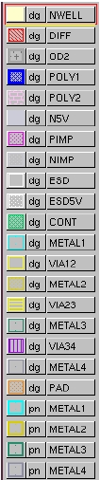
Layout-Editor
11
Layer Table->(Window -> Layer Table ->Attach Left
DIFF :OD1,active region
Poly : Poly gate
PIMP: P+ implant
NIMP: N+ implant
Metal1: Metal_1
Metal2:Metal_2
Metal3:Metal_3
Metal4:Metal_4
dg : draw the shape
pn : input/output pin
11

Slide 12


Laker shortcut key (1/2)
12
Undo : <u>
Redo : <Shift + u>
Zoom area : <z>
Zoom in/out : <Ctrl/shift+Z>
Fit screen : <f>
Ruler : <k>
Remove rulers: <shift+k>
Rectangular: <r>
Stretch : <s>
Move: <m>
Copy: <c>
12

Slide 13


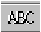
Laker shortcut key (2/2)
13
Release attitudes: <ESC>
Delete: <Del>
Guard Ring: <shift+g>
Polygon : <shift + p>
Path : <p>
Label/pin : <l>
Instance : <i>
13

Slide 14
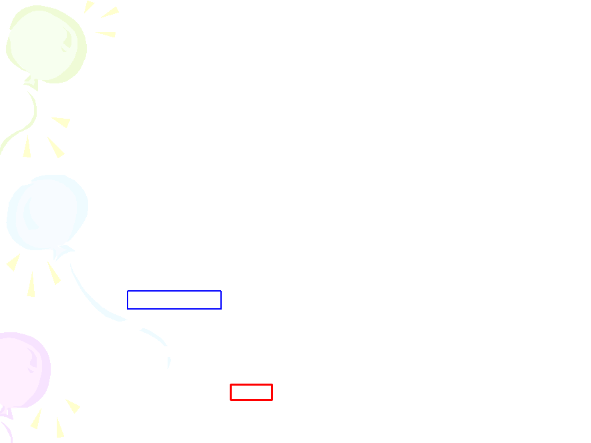
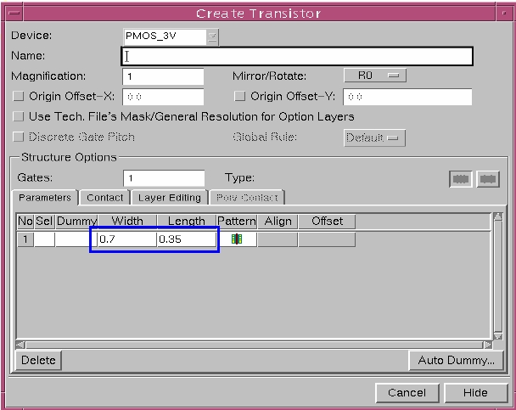
Insert MOS (1/3)
14
Create MOS < ctrl+m>
14

Slide 15
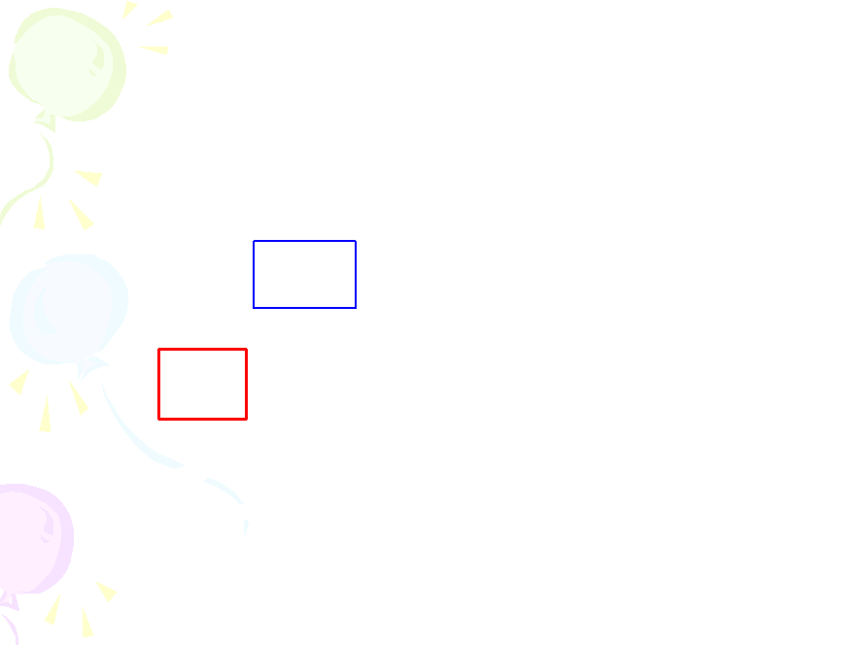
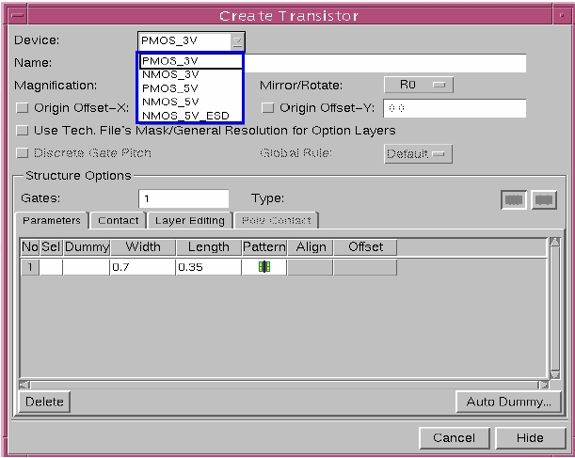
Insert MOS (2/3)
15
Select I/O Device
15

Slide 16

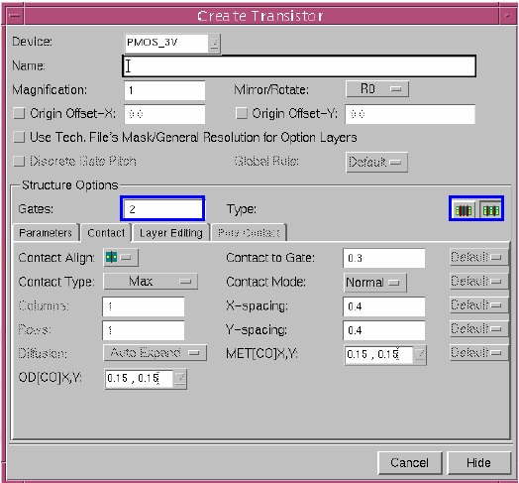
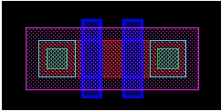
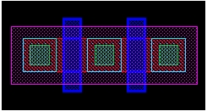
Insert MOS (3/3)
Select Gate number & Condition
16

Slide 17

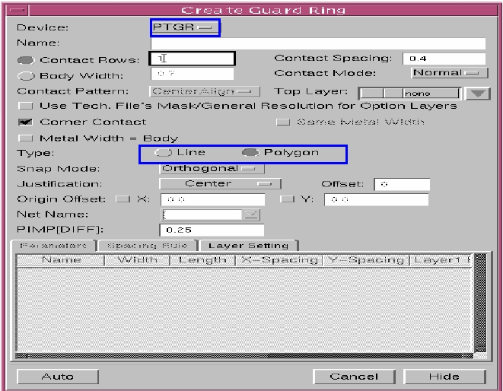
Guard Ring
17
Click <shift +g> NMOS ->P-guard ring/PMOS->N-guard ring
17

Slide 18

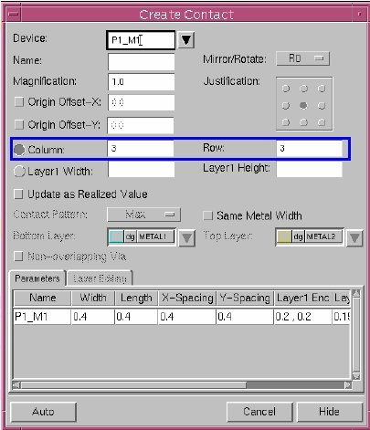
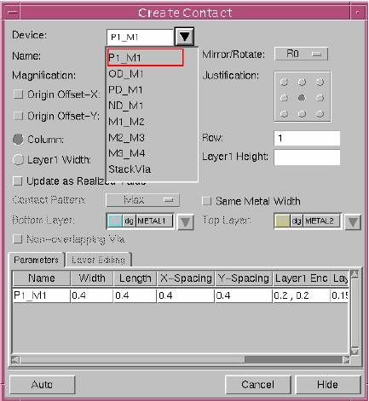
Insert Contact
18
Create Contact/Via <o>-Press o -> choose contact-> Press Hide
18

Slide 19
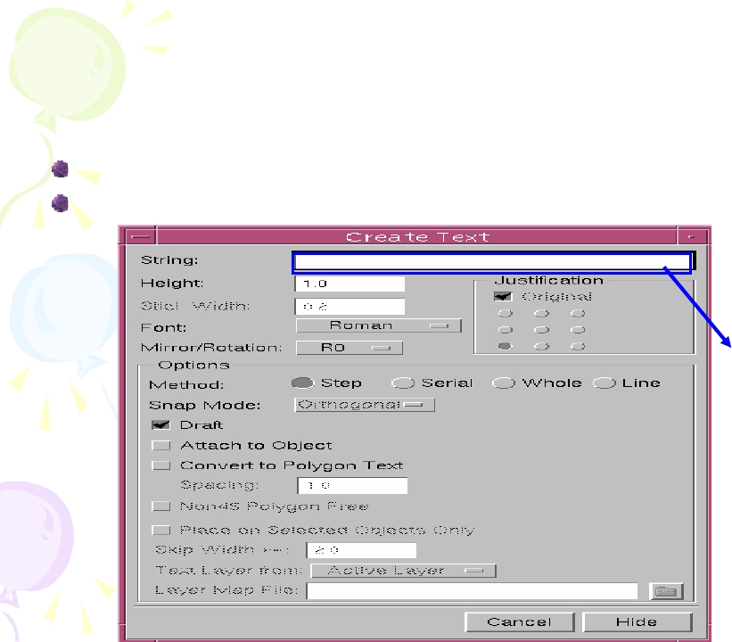
Label/Pin
19
Create Label/Pin <l>
Press l -> key on text -> Press Hide
按<L>
Key in Name
19

Slide 20
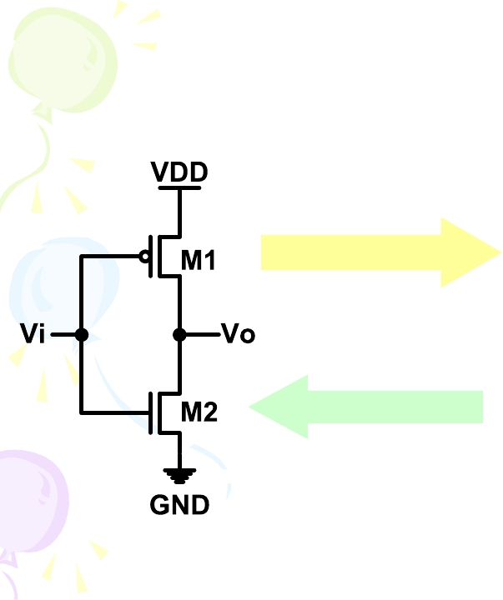
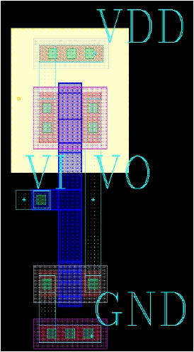
DRC flow chart
20
Layout Design
DRC Check
20

Slide 21

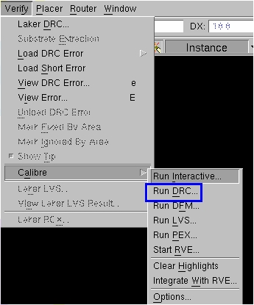
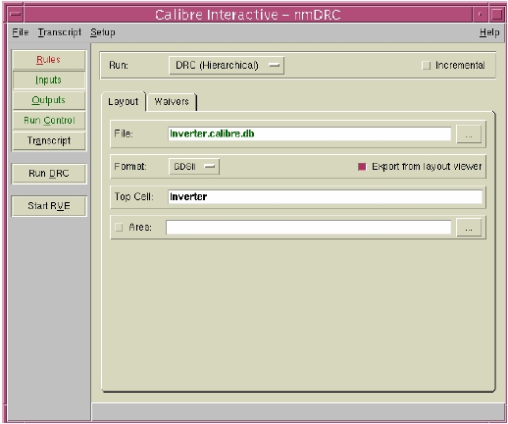
Calibre DRC(1/4)
21
Verify-> Calibre-> Run DRC
21

Slide 22
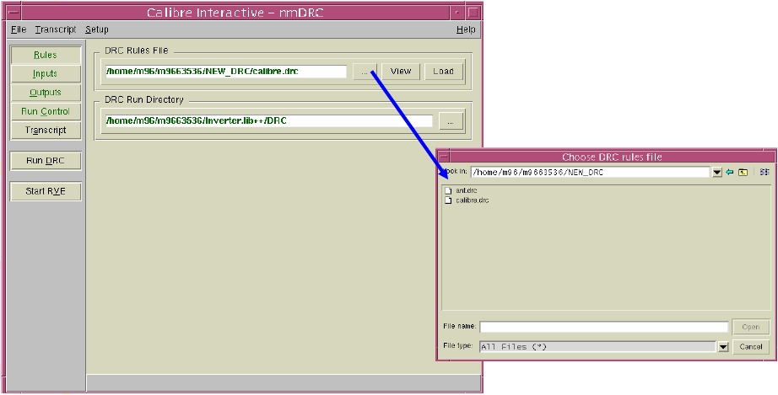
Calibre DRC(2/4)
22
Rules-> Calibre DRC Rule Files xxxx.drc ->DRC Run Directory
22

Slide 23
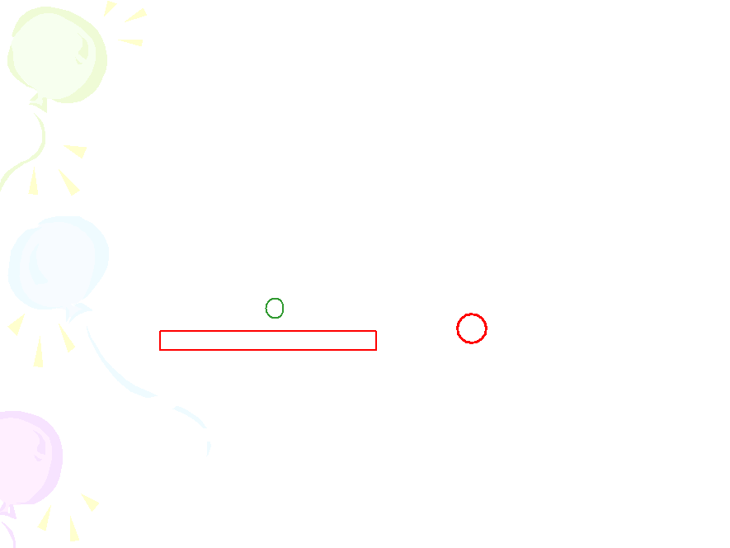
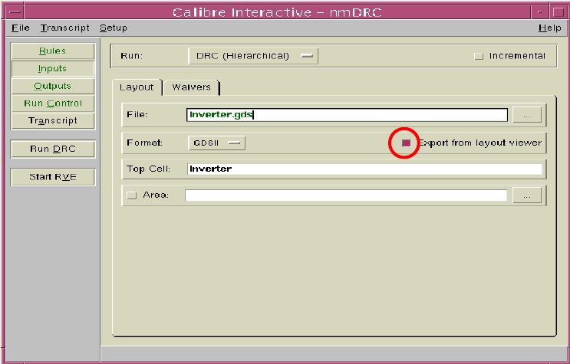
Calibre DRC(3/4)
23
Input-> File (xxx.gds) -> Export from layout viewer->Top cell
->Run DRC
23

Slide 24

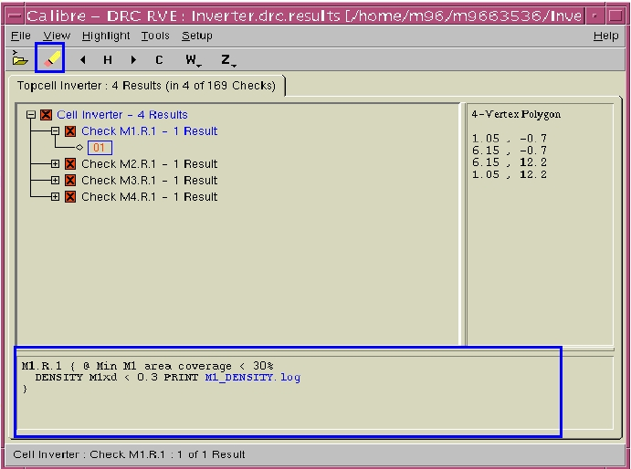
Calibre DRC(4/4)
24
If there is error, please check error message then debug!
24

Slide 25
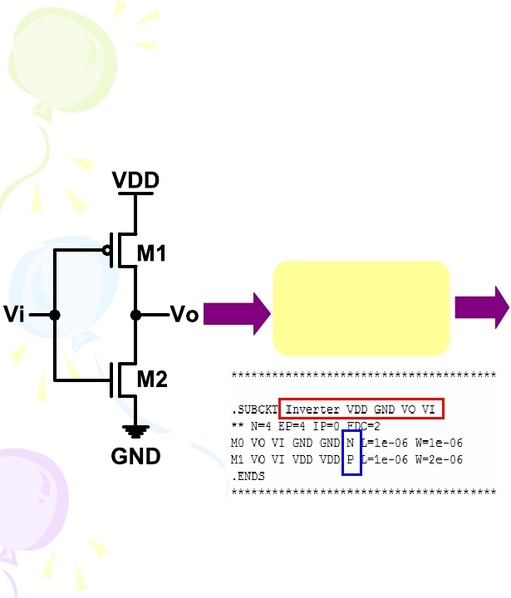
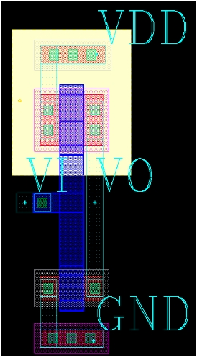
Calibre LVS Flow Chart
25
LVS
25

Slide 26
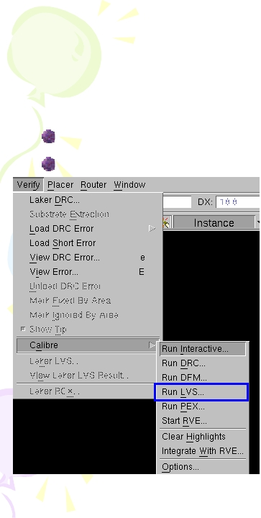
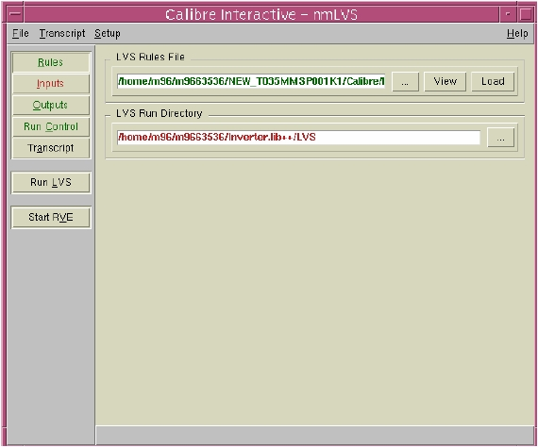
Calibre LVS(1/4)
26
Verify->Calibre ->Run LVS
Rules->Select LVS Rules-> Select LVS Run Directory
26

Slide 27
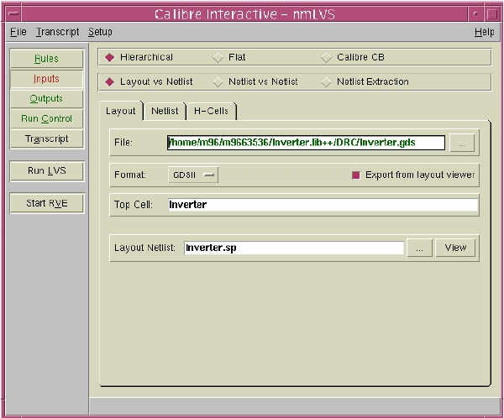
Calibre LVS(2/4)
27
Input->Layout set as DRC
27

Slide 28

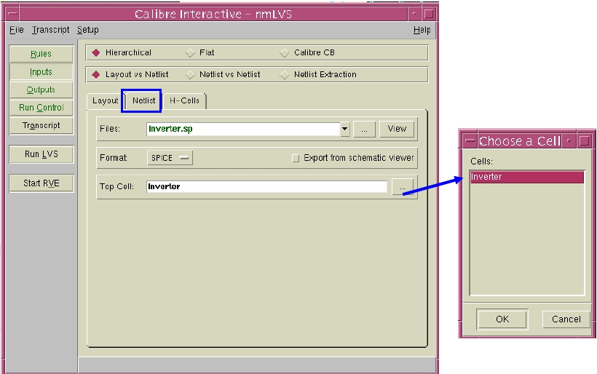
Calibre LVS(3/4)
28
Input-> Netlist ->Select File -> Top Cell->Press Run
28

Slide 29
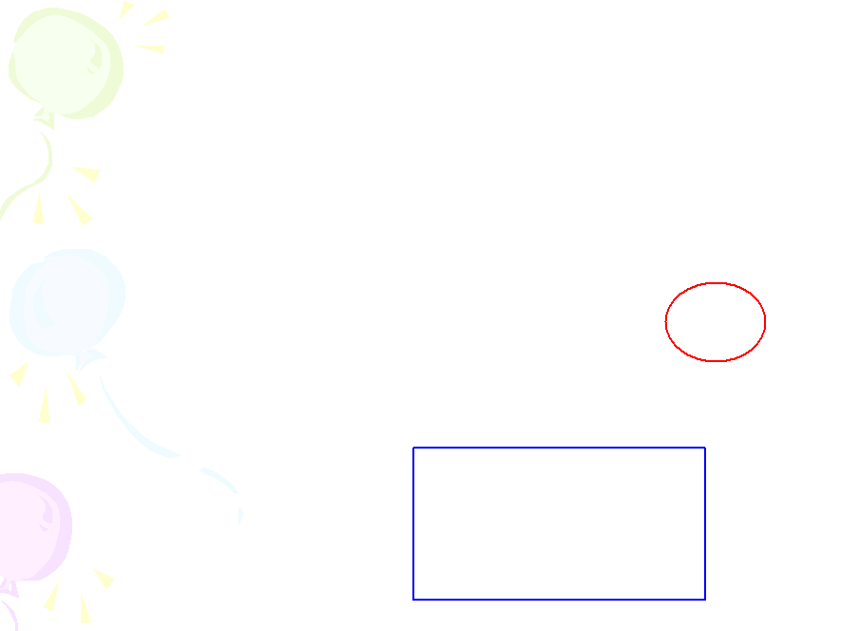
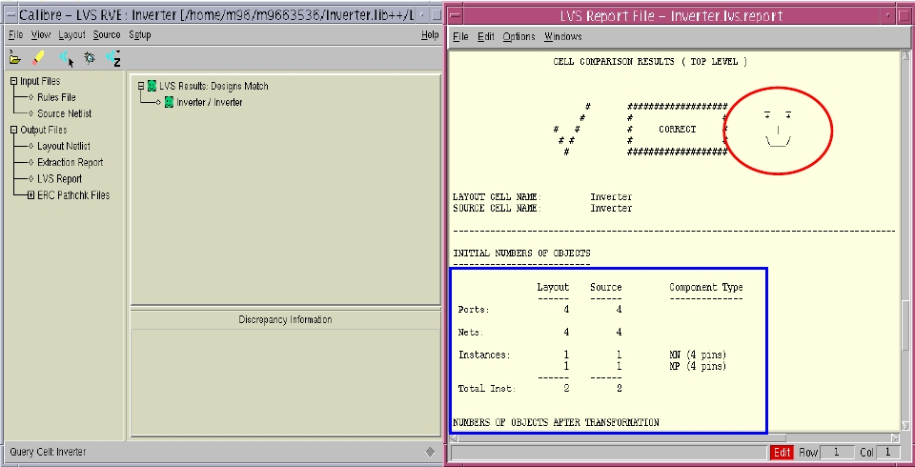
Calibre LVS(4/4)
29
Confirm「 Layout 」&「Schematic」
29

Slide 30
30
Calibre PEX Verification
30

Slide 31
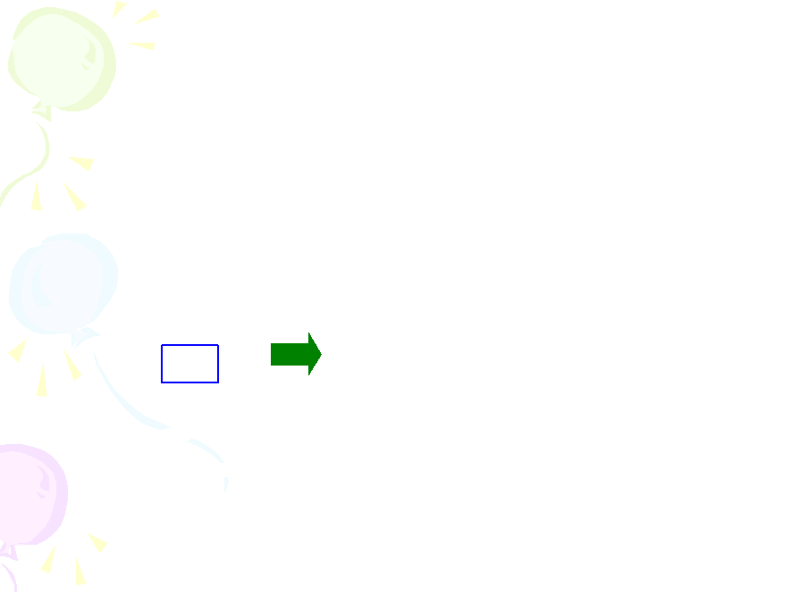
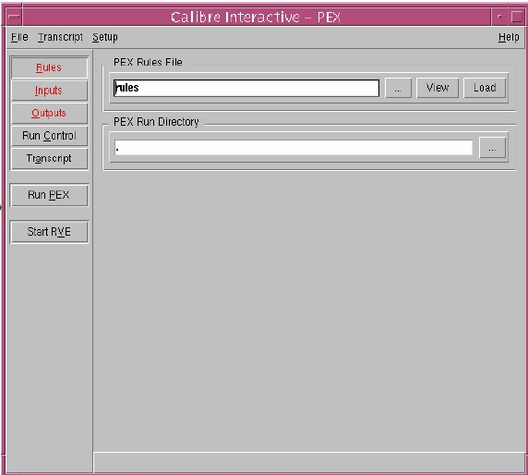
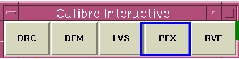
Calibre PEX (1/5)
31
Calibre –gui & ->Rule-> Select PEX rule file ->Select PEX Run
Directory
31

Slide 32
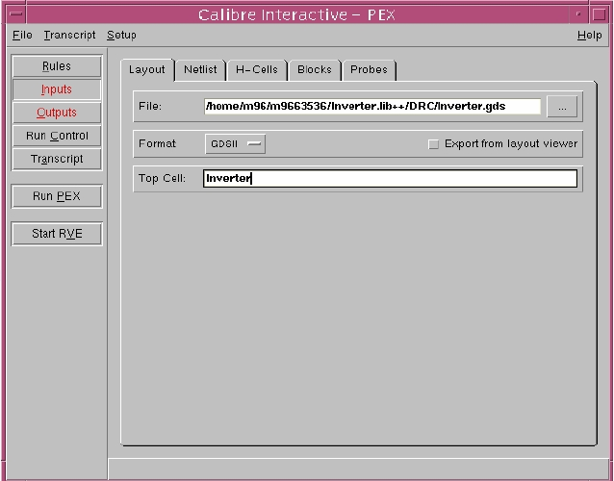
Calibre PEX (2/5)
32
Input->Layout set as DRC
32

Slide 33
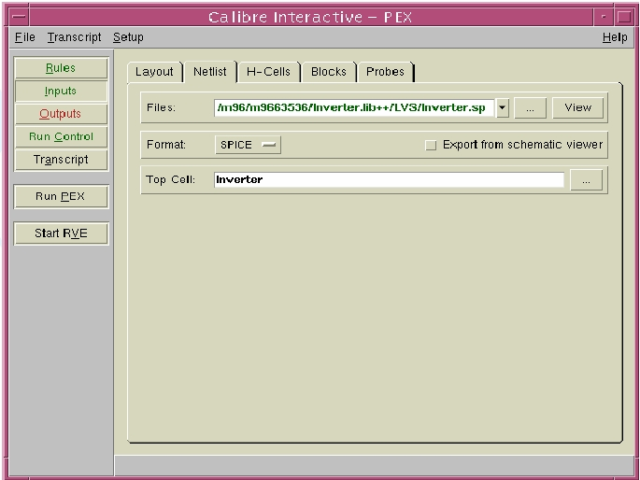
Calibre PEX (3/5)
33
Input-> Netlist ->Select File -> Top Cell
33

Slide 34
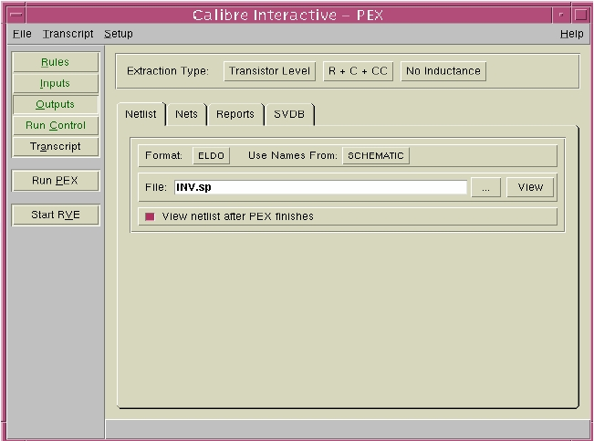
Calibre PEX (4/5)
34
Output-> Select Extraction Type (R+C+CC) -> File ->Key in
output file name ->Press Run
34

Slide 35
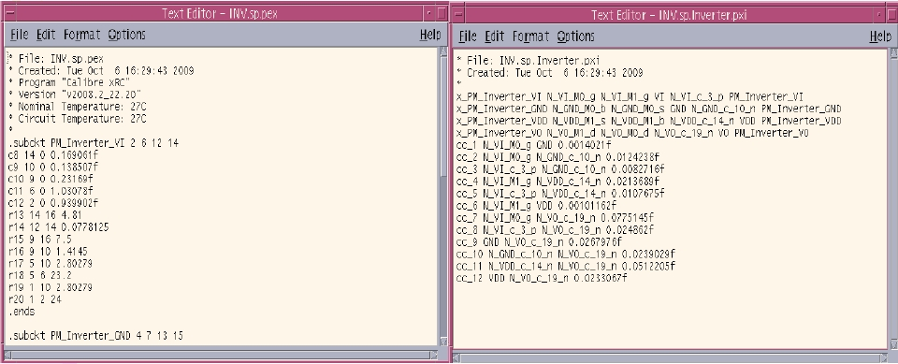
Calibre PEX (5/5)
Parasitic Extraction
35

